Slide 1

PROGRAMMING FUNDAMENTALS
PROJECT BY : MEHREEN ZAKA AND SUBAINA PERVAIZ
ROLL NO: 23L-2613,23L-4047

Slide 2

FILE HANDLING AND IMAGE TRANSFORMATIONS

Slide 3
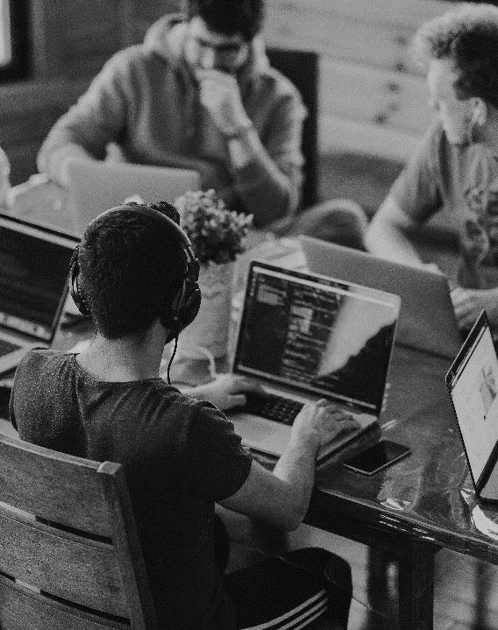
Project description
Containing 20 Functions
This mini-project focuses on developing a menu-driven program for digital image processing using ASCII PGM files. The program offers file handling functionalities like opening and saving files. The goal is to provide a comprehensive set of tools inspired by commonly used image processing Irfan-view software.

Slide 4

FOLLOWING SLIDES CONTAIN 20 FUNCTIONS OF OUR PROJECT
LET US MOVE FURHER!

Slide 5
1.LOAD IMAGE
int loadImage(const char ImageName[]) {
ifstream FCIN("C:\\Users\\my computer & laptop\\Downloads\\khan.pgm");
ifstream secondimage("C:\\Users\\my computer & laptop\\Downloads\\imranwithjem.pgm");
if (!FCIN.is_open())
return -1;
char MagicNumber[5];
char Comment[100];
FCIN.getline(MagicNumber, 4);
FCIN.getline(Comment, 100);
FCIN >> cols >> rows >> maxGray;
ImageData.clear();
ImageData.resize(rows, vector<int>(cols, 0));
for (int r = 0; r < rows; r++)
for (int c = 0; c < cols; c++)
FCIN >> ImageData[r][c];
if (FCIN.fail())
return -2;
FCIN.close();
imageLoaded = true;
imageModified = false;
strcpy_s(ImageFileName, ImageName);
return 0;
}

Slide 6
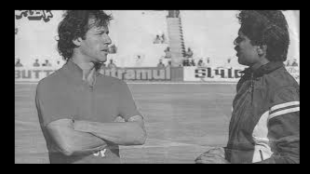
1.LOAD IMAGE
BEFORE:
AFTER:

Slide 7
2.Save image
int saveImage(const char ImageName[]) {
ofstream FCOUT("C:\\Users\\my computer & laptop\\Downloads\\khan.pgm");
if (!FCOUT.is_open())
return -1;
FCOUT << "P2\n# This is a comment\n"
<< cols << " " << rows << endl << maxGray << endl;
for (int r = 0; r < rows; r++) {
for (int c = 0; c < cols; c++)
FCOUT << ImageData[r][c] << " ";
FCOUT << endl;
}
FCOUT.close();
imageModified = false;
return 0;
}

Slide 8
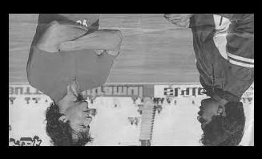
3.Vertical flip
void verticalFlip() {
for (int r = 0; r < rows / 2; r++)
for (int c = 0; c < cols; c++) {
int Temp = ImageData[r][c];
ImageData[r][c] = ImageData[rows - r - 1][c];
ImageData[rows - r - 1][c] = Temp;
}
}
BEFORE:
AFTER:

Slide 9
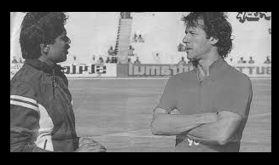
4.HORIZONTAL flip
void horizontalFlip() {
for (int r = 0; r < rows; r++)
for (int c = 0; c < cols / 2; c++) {
int Temp = ImageData[r][c];
ImageData[r][c] = ImageData[r][cols - c - 1];
ImageData[r][cols - c - 1] = Temp;
}
}
BEFORE:
AFTER:

Slide 10
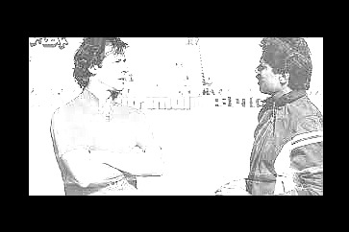
5.CHANGE BRIGHTNESS
void Brightness(double factor) {
for (int r = 0; r < rows; r++)
for (int c = 0; c < cols; c++) {
ImageData[r][c] = static_cast<int>(ImageData[r][c] * factor);
if (ImageData[r][c] > maxGray)
ImageData[r][c] = maxGray;
}
}
BEFORE:
AFTER:

Slide 11
6.SCALE IMAGE
void scaleImage(int scaleFactor) {
int newRows = round(rows * scaleFactor);
int newCols = round(cols * scaleFactor);
// Allocate memory for newImageData on the heap
vector<vector<int>> newImageData(newRows, vector<int>(newCols, 0));
for (int r = 0; r < newRows; r++) {
for (int c = 0; c < newCols; c++) {
int originalR = static_cast<int>(round(r / scaleFactor));
int originalC = static_cast<int>(round(c / scaleFactor));
// Ensure the indexs are within bounds
originalR = max(0, min(originalR, rows - 1));
originalC = max(0, min(originalC, cols - 1));
newImageData[r][c] = ImageData[originalR][originalC];
}
}
// Update the image data with the scaled data
ImageData = newImageData;
rows = newRows;
cols = newCols;
imageModified = true;
}

Slide 12
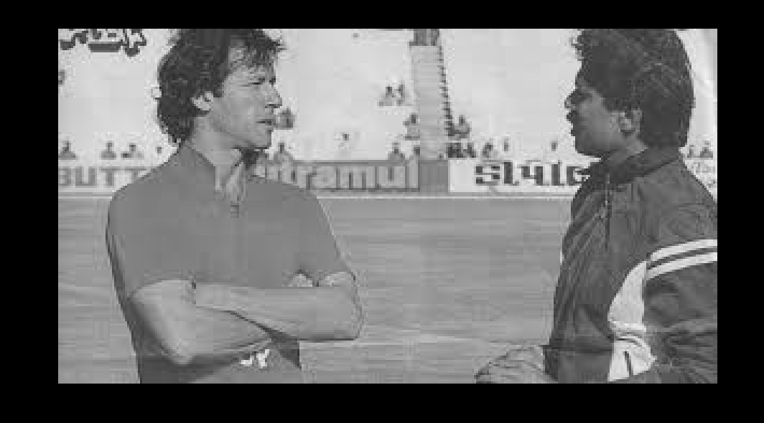
6.SCALE IMAGE
BEFORE:
AFTER:

Slide 13

7.TRANSLATE IMAGE
void Translate(int dx, int dy) {
unsigned int newimagedata[400][400];
for (int r = 0; r < rows; r++) {
for (int c = 0; c < cols; c++) {
newimagedata[r][c] = 0;
}
}
for (int r = 0; r < rows; r++) {
for (int c = 0; c < cols; c++) {
int newr = r - dy;
int newc = c - dx;
// Check if the translated position is within bounds
if (newr >= 0 && newr < rows && newc >= 0 && newc < cols) {
newimagedata[r][c] = ImageData[newr][newc]; }
}
}
// Copy the translated image back to the original image
for (int r = 0; r < rows; r++) {
for (int c = 0; c < cols; c++) {
ImageData[r][c] = newimagedata[r][c];
}
}
imageModified = true;
}

Slide 14
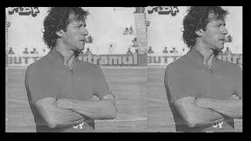
7.TRANSLATE IMAGE
BEFORE:
AFTER:

Slide 15
8.rotate IMAGE
void Rotate(double theta) {
char rotationDirection;
cout << "Enter 'a' for clockwise or 'b' for anticlockwise: ";
cin >> rotationDirection;
bool clockwise = (rotationDirection == 'a' || rotationDirection == 'A');
double ct, st;
theta *= 3.1415;
theta /= 180;
ct = cos(theta);
st = sin(theta);
vector<vector<int>> DV(rows, vector<int>(cols, 255));
int counter = 0;
for (int r = 0; r < rows; r++) {
for (int c = 0; c < cols; c++) {
int nr, nc;
nr = (int)(ct * r - st * c);
nc = (int)(st * r + ct * c);
if ((0 <= nr) && (nr < rows) && (0 <= nc) && (nc < cols))
DV[nr][nc] = ImageData[r][c];}
}
ImageData = DV;
}

Slide 16
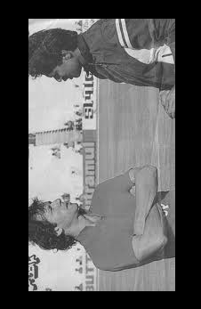
8.rotaTE IMAGE
BEFORE:
AFTER:

Slide 17
9.sharpen IMAGE
void Sharpen(double strength) {
vector<vector<int>> laplacianFilter = { // Laplacian filter for sharpening
{-1, -1, -1},
{-1, 8, -1},
{-1, -1, -1}
};
int filterSize = laplacianFilter.size();
int filterRadius = filterSize / 2;
// Create a temporary copy of the image
vector<vector<int>> tempImageData = ImageData;
for (int r = filterRadius; r < rows - filterRadius; r++) {
for (int c = filterRadius; c < cols - filterRadius; c++) {
int sum = 0;
for (int i = -filterRadius; i <= filterRadius; i++) { // Apply Laplacian filter
for (int j = -filterRadius; j <= filterRadius; j++) {
sum = sum + laplacianFilter[i + filterRadius][j + filterRadius] * ImageData[r + i][c + j]; }
}

Slide 18
9.sharpen IMAGE
// Adjust pixel value based on the strength parameter
int newValue = static_cast<int>(ImageData[r][c] + strength * sum);
// Ensure the new pixel value is within the valid range [0, maxGray]
newValue = max(0, min(newValue, maxGray));
tempImageData[r][c] = newValue;
}
}
ImageData = tempImageData; // Update the image data with the sharpened data
imageModified = true;
}

Slide 19
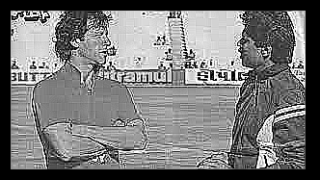
9.sharpen IMAGE
BEFORE:
AFTER:

Slide 20
10.contrast IMAGE
void EnhanceContrast() {
int minIntensity = maxGray;
int maxIntensity = 0;
// Find the minimum and maximum pixel values in the image
for (int r = 0; r < rows; r++) {
for (int c = 0; c < cols; c++) {
minIntensity = min(minIntensity, ImageData[r][c]);
maxIntensity = max(maxIntensity, ImageData[r][c]);
}
}
// Apply linear contrast stretching to scale pixel values to the full range
for (int r = 0; r < rows; r++) {
for (int c = 0; c < cols; c++) {
ImageData[r][c] = static_cast<int>(
(ImageData[r][c] - minIntensity) * (maxGray - 1) / max(1, maxIntensity - minIntensity)
);
}
}
imageModified = true;
}

Slide 21
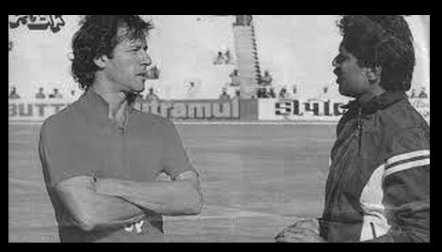
10.contrast IMAGE
BEFORE:
AFTER:

Slide 22
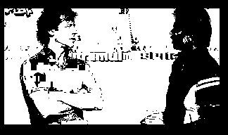
11.convert IMAGE to binary
void ConvertToBinary() {
for (int r = 0; r < rows; r++) {
for (int c = 0; c < cols; c++) {
// If the pixel value is >= to half of maxGray,set it to maxGray,otherwise set to 0
ImageData[r][c] = (ImageData[r][c] >= maxGray / 2) ? maxGray : 0;
}
}
imageModified = true;
}
BEFORE:
AFTER:

Slide 23
12.Resize IMAGE
void ResizeImage(int newRows, int newCols) {
// Allocate memory for newImageData on the heap
vector<vector<int>> newImageData(newRows, vector<int>(newCols, 0));
double scaleRow = static_cast<double>(rows) / newRows;
double scaleCol = static_cast<double>(cols) / newCols;
for (int r = 0; r < newRows; r++) {
for (int c = 0; c < newCols; c++) {
int originalR = static_cast<int>(r * scaleRow);
int originalC = static_cast<int>(c * scaleCol);
// Ensure the indexs are within bounds
originalR = max(0, min(originalR, rows - 1));
originalC = max(0, min(originalC, cols - 1));
newImageData[r][c] = ImageData[originalR][originalC];
}
}
// Update the image data with the resized data
ImageData = newImageData;
rows = newRows;
cols = newCols;
imageModified = true;
}

Slide 24
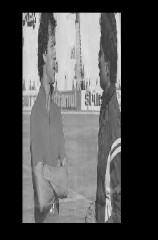
12.resizE IMAGE
BEFORE:
AFTER:

Slide 25
13.crop IMAGE
void Crop(int startRow, int startCol, int endRow, int endCol) {
// Validate the input coordinates
if (startRow < 0 || startCol < 0 || endRow >= rows || endCol >= cols || startRow >= endRow || startCol >= endCol) {
cout << "Invalid cropping coordinates." << endl;
return;
}
// Calculate the size of the cropped region
int newRows = endRow - startRow + 1;
int newCols = endCol - startCol + 1;
// Allocate memory for newImageData on the heap
vector<vector<int>> newImageData(newRows, vector<int>(newCols, 0));
for (int r = 0; r < newRows; r++) {
for (int c = 0; c < newCols; c++) {
newImageData[r][c] = ImageData[startRow + r][startCol + c]; }
}
// Update the image data with the cropped data
ImageData = newImageData;
rows = newRows; cols = newCols;
imageModified = true;
}

Slide 26
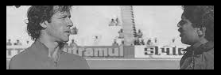
13.crop IMAGE
BEFORE:
AFTER:

Slide 27

14.Manipulate intensity of IMAGE
void ManipulateIntensity(double intensityFactor) {
for (int r = 0; r < rows; r++) {
for (int c = 0; c < cols; c++) {
ImageData[r][c] = static_cast<int>(ImageData[r][c] * intensityFactor);
if (ImageData[r][c] > maxGray) {
ImageData[r][c] = maxGray;
}
}
}
imageModified = true;
}
BEFORE:
AFTER:

Slide 28
15.Derivative of IMAGE
void FindDerivative() {
// Derivative mask filter
vector<vector<int>> derivativefilter = {
{-1, 0, 1},
{-1, 0, 1},
{-1, 0, 1}
};
int filterSize = derivativefilter.size();
int filterRadius = filterSize / 2;
// Create a temporary copy of the image
vector<vector<int>> tempImageData = ImageData;
for (int r = filterRadius; r < rows - filterRadius; r++) {
for (int c = filterRadius; c < cols - filterRadius; c++) {
int sum = 0;
for (int i = -filterRadius; i <= filterRadius; i++) { // Apply derivative filter
for (int j = -filterRadius; j <= filterRadius; j++) {
sum = sum + derivativefilter[i + filterRadius][j + filterRadius] * ImageData[r + i][c + j]; } }
// Set the pixel value to the computed derivative
tempImageData[r][c] = sum; } }
ImageData = tempImageData; // Update the image data with the computed derivative
imageModified = true;
}

Slide 29
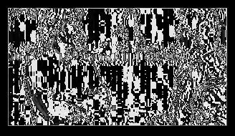
15.Derivative of IMAGE
BEFORE:
AFTER:

Slide 30
16.Find edges of IMAGE
void FindEdges() {
// Derivative mask filters for horizontal and vertical edges
vector<vector<int>> horizontalFilter = {
{-1, 0, 1},
{-2, 0, 2},
{-1, 0, 1}
};
vector<vector<int>> verticalFilter = {
{-1, -2, -1},
{ 0, 0, 0},
{ 1, 2, 1}
};
int filterSize = horizontalFilter.size();
int filterRadius = filterSize / 2;
vector<vector<int>> tempImageData = ImageData;
// Create a temporary copy of the image
for (int r = filterRadius; r < rows - filterRadius; r++) {
for (int c = filterRadius; c < cols - filterRadius; c++) {
int sumX = 0, sumY = 0;

Slide 31
16.Find edges of IMAGE
// Apply horizontal and vertical filters
for (int i = -filterRadius; i <= filterRadius; i++) {
for (int j = -filterRadius; j <= filterRadius; j++) {
sumX= sum +horizontalFilter[i + filterRadius][j + filterRadius] * ImageData[r + i][c +j];
sumY= sum + verticalFilter[i + filterRadius][j + filterRadius] * ImageData[r + i][c + j]; }
}
int gradientMagnitude = static_cast<int>(sqrt(sumX * sumX + sumY * sumY));
// Compute the gradient magnitude
// Set the pixel value to the computed gradient magnitude
tempImageData[r][c] = gradientMagnitude;
}
}
// Update the image data with the computed edges
ImageData = tempImageData;
imageModified = true;
}

Slide 32
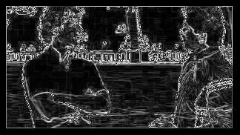
16.Find edges of IMAGE
BEFORE:
AFTER:

Slide 33
17.combine IMAGEs
void CombineImagesSideBySide(const Image& secondImage) {
if (rows != secondImage.rows) {
cout << "Error: Images must have the same number of rows for combining." << endl;
return;
}
int newCols = cols + secondImage.cols;
// Allocate memory for the combined image data on the heap
vector<vector<int>> combinedImageData(rows, vector<int>(newCols, 0));
// Copy the data from the first image to the combined image
for (int r = 0; r < rows; r++) {
for (int c = 0; c < cols; c++) {
combinedImageData[r][c] = ImageData[r][c]; }
}
// Copy the data from the second image to the combined image
for (int r = 0; r < rows; r++) {
for (int c = 0; c < secondImage.cols; c++) {
combinedImageData[r][cols + c] = secondImage.ImageData[r][c]; }
}
// Update the image data with the combined data
ImageData = combinedImageData;
cols = newCols;
imageModified = true;
}

Slide 34
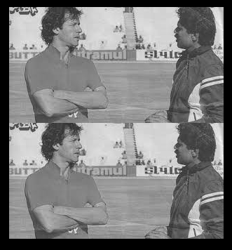
17.combine IMAGEs
BEFORE:
AFTER:

Slide 35
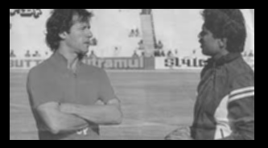
18.Mean filter on IMAGE
void MeanFilter() {
vector<vector<int>> newImageData(rows, vector<int>(cols, 0));
for (int r = 1; r < rows - 1; ++r) {
for (int c = 1; c < cols - 1; ++c) {
int sum = 0;
for (int i = -1; i <= 1; ++i) {
for (int j = -1; j <= 1; ++j) {
sum = sum + ImageData[r + i][c + j]; } }
newImageData[r][c] = sum / 9; // 3x3 mean filter; } }
ImageData = newImageData; // Update the image data with the filtered data
imageModified = true; }
BEFORE:
AFTER:

Slide 36
19.Median filter on IMAGE
void MedianFilter() {
vector<vector<int>> newImageData(rows, vector<int>(cols, 0));
for (int r = 1; r < rows - 1; r++) {
for (int c = 1; c < cols - 1; c++) {
vector<int> value;
for (int i = -1; i <= 1; ++i) {
for (int j = -1; j <= 1; ++j) {
value.push_back(ImageData[r + i][c + j]);
}
}
// Sort the values to find the median
sort(value.begin(), value.end());
newImageData[r][c] = value[4]; // 3x3 median filter
}
}
// Update the image data with the filtered data
ImageData = newImageData;
imageModified = true;
}

Slide 37
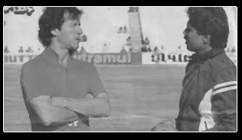
19.Median filter on IMAGE
BEFORE:
AFTER:

Slide 38
20.LINEAR IMAGE FILTER
// Function to apply linear filter to an image
void LinearFilter(const string& imagePath, const string& filterPath) {
// Load the image
ifstream imageFile("C:\\Users\\my computer & laptop\\Downloads\\khan.pgm");
if (!imageFile.is_open()) {
cout << "Error opening image file." << endl;
return;
}
// Read image properties
string format;
int imageSize, maxPixelValue;
imageFile >> format >> imageSize >> imageSize >> maxPixelValue;
// Load the image data
vector<vector<int>> imageData(imageSize, vector<int>(imageSize));
for (int i = 0; i < imageSize; ++i) {
for (int j = 0; j < imageSize; ++j) {
imageFile >> imageData[i][j];
}
}
imageFile.close();

Slide 39
20.LINEAR IMAGE FILTER
// Load the filter
ifstream filterFile("C:\\Users\\my computer & laptop\\Downloads\\itisfilterfile\\filterfile");
if (!filterFile.is_open()) {
cout << "Error opening filter file." << endl;
return;
}
// Read filter data
vector<vector<int>> filter(imageSize, vector<int>(imageSize));
for (int i = 0; i < imageSize; ++i) {
for (int j = 0; j < imageSize; ++j) {
filterFile >> filter[i][j];
}
}
filterFile.close();

Slide 40
20.LINEAR IMAGE FILTER
// Apply the filter to the image
vector<vector<int>> newImageData(imageSize, vector<int>(imageSize, 0));
for (int i = 1; i < imageSize - 1; ++i) {
for (int j = 1; j < imageSize - 1; ++j) {
int sum = 0;
for (int x = 0; x < 3; ++x) {
for (int y = 0; y < 3; ++y) {
sum += imageData[i - 1 + x][j - 1 + y] * filter[x][y];
}
}
newImageData[i][j] = sum;
}
}
// Save the changes to the original image file
ofstream resultFile("C:\\Users\\my computer & laptop\\Downloads\\khan.pgm");
if (!resultFile.is_open()) {
cout << " Error saving changes to image file." << endl;
return;
}

Slide 41
20.LINEAR IMAGE FILTER
// Save the new image properties
resultFile << format << endl;
resultFile << imageSize << " " << imageSize << endl;
resultFile << maxPixelValue << endl;
// Save the new image data
for (int i = 0; i < imageSize; ++i) {
for (int j = 0; j < imageSize; ++j) {
resultFile << imageData[i][j] << " ";
}
resultFile << endl;
}
resultFile.close();
}

Slide 42
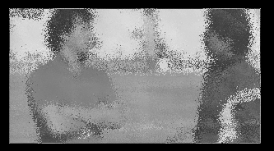
20.LINEAR IMAGE FILTER
BEFORE:
AFTER:

Slide 43
Difficulties faced during the project
FIXING DIFFERENT ERRORS
STATIC CAST
INITIALIZING DOUBLE TO INT
COMBINING IMAGES FUNCTION

Slide 44

CONCLUSION

Slide 45
THE END!

Slide 46



THANK YOU
mehreenNsubaina
+1 (589) 555-0199
mehreen@subaina.com
WWW.SUBREEN.COM

